Slide 1
Lecture 3: Introduction to Large Language Models II – Reasoning Language Models
Instructor: Zhanzhan Zhao

Slide 2
Recap, Quiz and Tech Question / Project Idea 1

Slide 3
Capable LLMs (this time)
Skills using LLMs (last time)
Know LLMs well
Know some tricks (prompt skills)
Your own domain skills (last time)
Structured guide
Detailed guide
Customize to your language style
What makes a Good Prompt Engineer?

Slide 4
Skills using LLMs - Know LLMs Well
Multimodal
Autoregressive Language Model
Q: explain why GPT 3/4 can’t answer math reasoning well (7 * 8 = ?)
Q: Can randomness be controlled?
Transformer Architecture
Q: What is attention span?
Q: What is GPT 4o’s attention span limit size?
Embedding
Q: does it matter whether you use Chinese or English to prompt?

Slide 5
Prompt Skills
Zero-shot / Few-shot
CoT
Few-shot CoT
Zero-shot CoT
Role playing

Slide 6
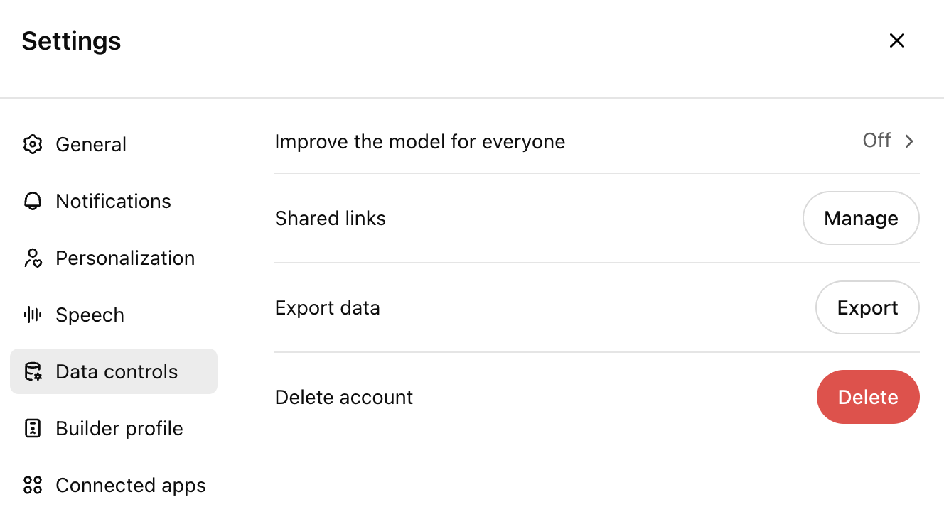
Technical Question 1/ Project Idea 1
Researchers / Creative writers / Software engineers' attitudes towards sharing novel info with LLMs. A survey.

Slide 7
W3: Intro II of Large Language Models:
Prompt Engineering (continued)
Reasoning Language Models
LLM API Usage (if time allows)
Activity:
Self-intros and paper sharings (graph RAG, deepseek R1, multi-agent LLMs)
Class practices of LLM API usage (if time allows)
Learning Goals:
• Familiarize students with advanced prompt skills
• Deeper understandings of reasoning language models
• Familiarize students with LLM API usage (if time allows)

Slide 8
Prompt Engineering (Continued)

Slide 9
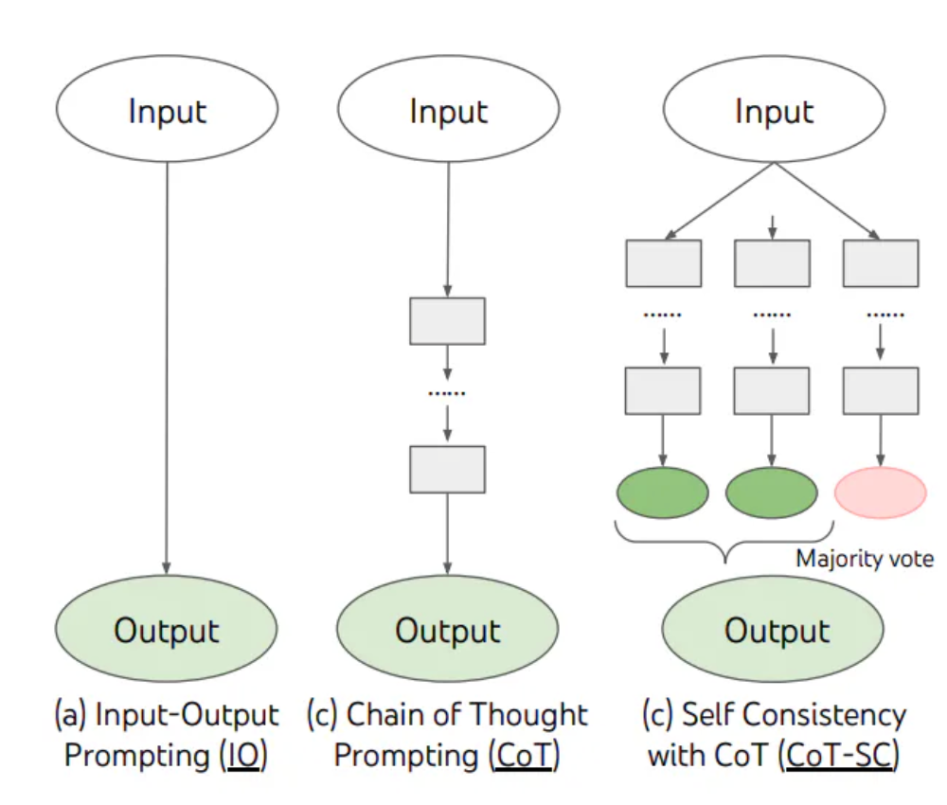
Prompt Skills
“Complex reasoning tasks typically admit multiple reasoning paths that reach a correct answer (Stanovich & West, 2000).”
Self-Consistency Prompting
Chain-of-Thought Prompting
Sampling Diverse Reasoning Paths
Majority Voting: the answer that appears most frequently is selected.

Slide 10
Prompt Skills
Self-Consistency Prompting
Prompt example:
Janet’s ducks lay 16 eggs per day. She eats three for breakfast every morning and bakes muffins for her friends every day with four. She sells the remainder for $2 per egg. How much does she make every day?
Your Task:
Use the chain of thought to break down the cost calculation.
Sample multiple reasoning paths.
Determine the most consistent calculation across different samples.
Chain-of-Thought Prompting
Sampling Diverse Reasoning Paths
Majority Voting

Slide 11
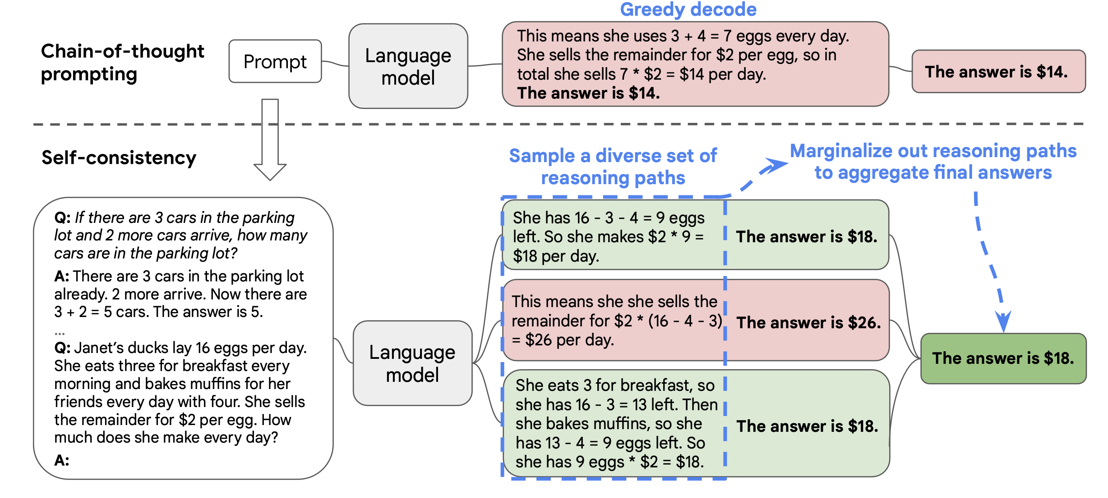
Prompt Skills
Self-Consistency Prompting
Pic from: https://arxiv.org/pdf/2203.11171

Slide 12
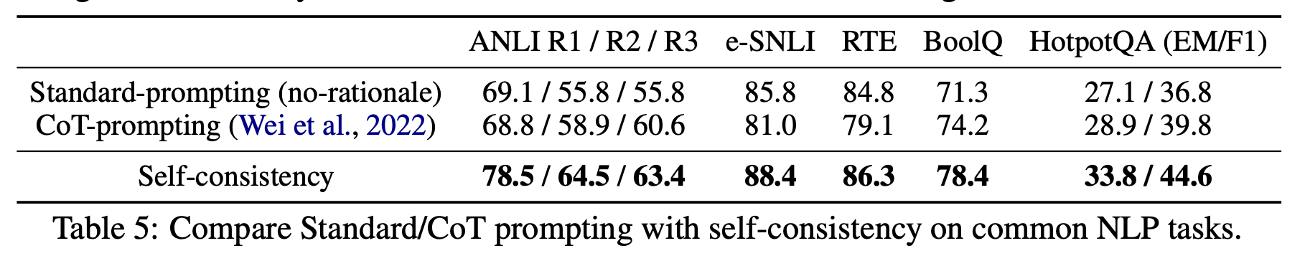
Prompt Skills
Self-Consistency Prompting
Pic from: https://arxiv.org/pdf/2203.11171

Slide 13
Prompt Skills
Self-Consistency Prompting
Chain-of-Thought Prompting
Sampling Diverse Reasoning Paths
Direct ask
Using API
Temperature Sampling
Top-k Sampling
Nucleus Sampling (Top-p Sampling)
Majority Voting

Slide 14
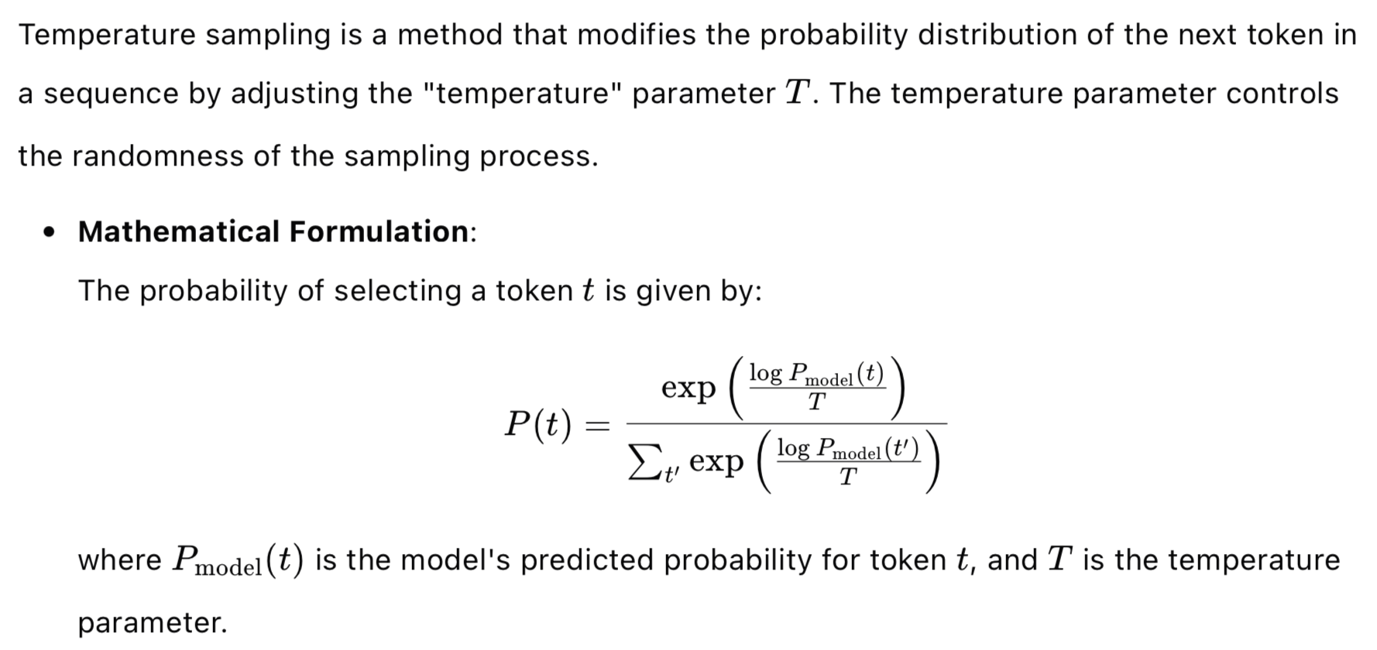
Prompt Skills: Sampling Diverse Paths
Temperature Sampling

Slide 15
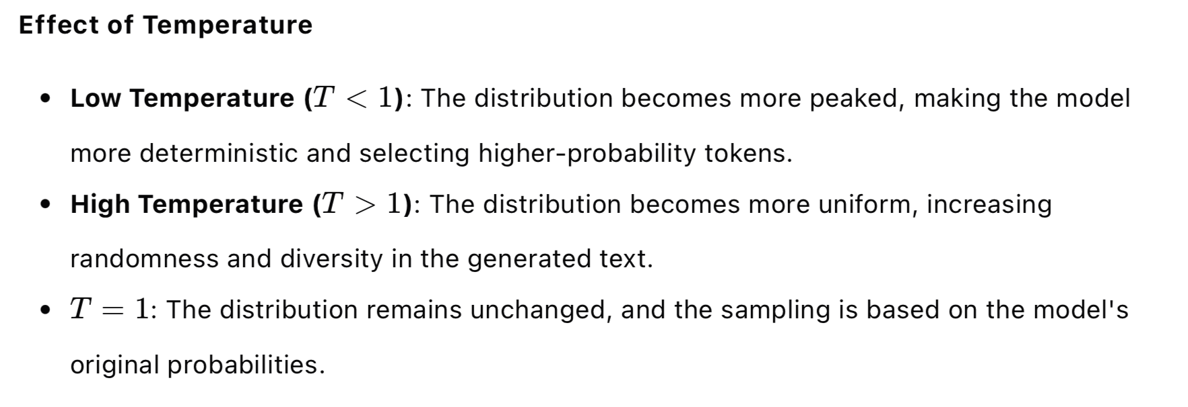
Prompt Skills: Sampling Diverse Paths
Temperature Sampling

Slide 16
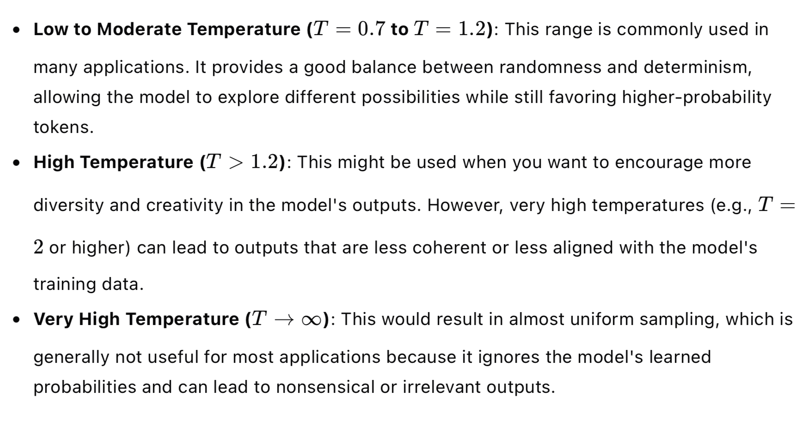
Prompt Skills: Sampling Diverse Paths
Temperature Sampling

Slide 17
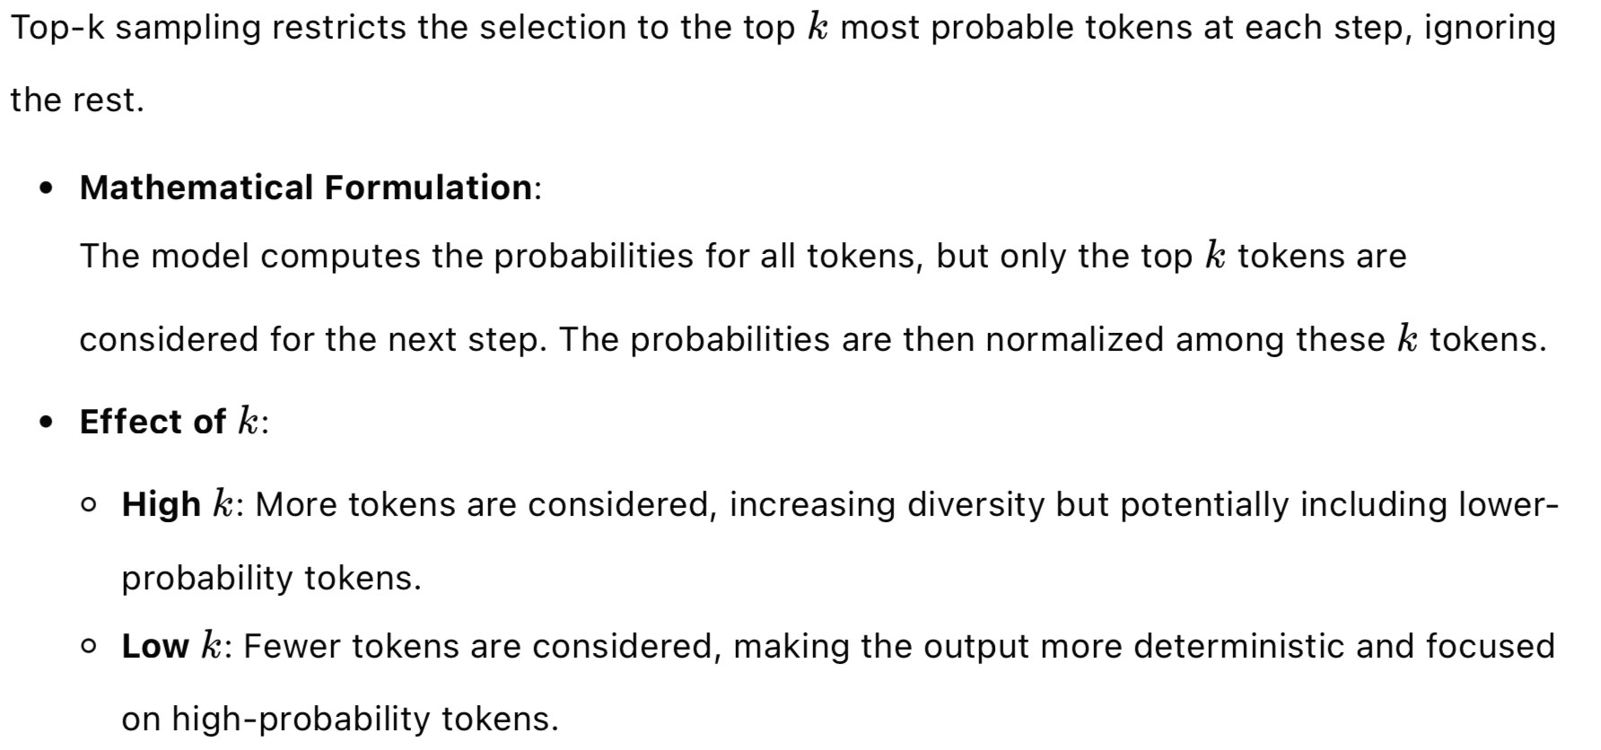
Prompt Skills: Sampling Diverse Paths
Top-k Sampling

Slide 18
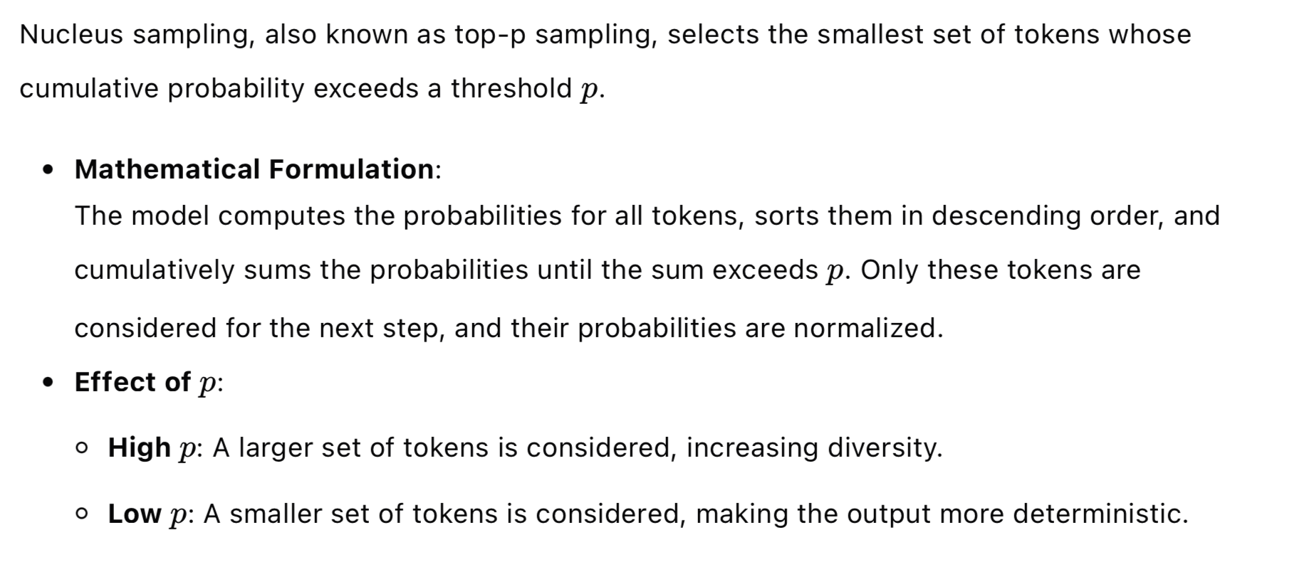
Prompt Skills: Sampling Diverse Paths
Nucleus Sampling (top-p Sampling)

Slide 19
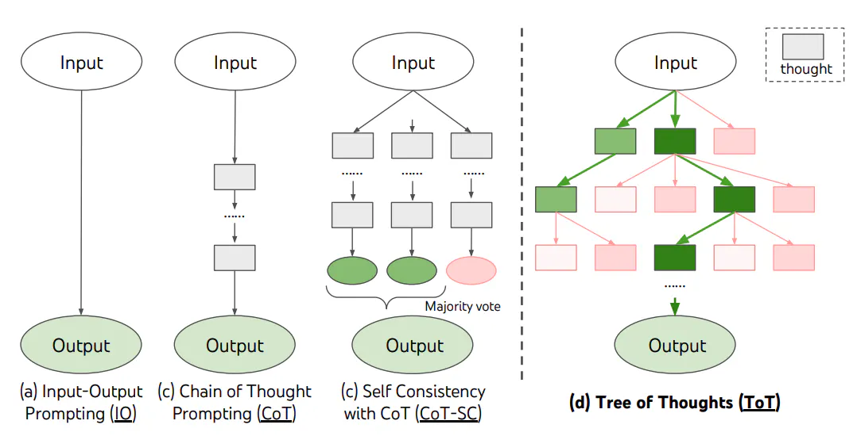
Prompt Skills
Tree of Thoughts (ToT) Prompting
Enables exploration over coherent thoughts that serve as intermediate steps toward problem solving.
For novel tasks requiring non-trivial planning or search
https://arxiv.org/pdf/2305.10601

Slide 20
Prompt Skills
Tree of Thoughts (ToT) Prompting
Thought Decomposition
Thought Generation
State Evaluation: Use voting to evaluate and select the most promising candidates.
Search Algorithm: Use breadth-first search (BFS) or depth-first search (DFS) to explore multiple paths and select the best one.

Slide 21
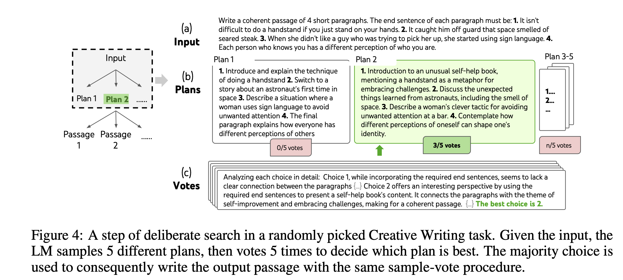
Prompt Skills
Tree of Thoughts (ToT) Prompting
Pic from https://arxiv.org/pdf/2305.10601

Slide 22
Prompt Skills
Retrieval Augmented Generation (RAG)
Example workflow
User Query: “When did the first mammal appear on the Earth?”
Retrieve Documents: RAG retrieves documents related to “Mammal,” “History of Earth,” and “Evolution of Mammals.”
Concatenate Context: The retrieved documents are concatenated with the original query.
Generate Response: LLM processes the concatenated input and generates a response, such as "The first mammals appeared around 220 million years ago."

Slide 23
Prompt Skills
Retrieval Augmented Generation (RAG)
Complex / Knowledge-Intensive / Localized Tasks:
Language models can be enhanced to access external knowledge sources.
This improves factual consistency and reliability of responses.
Mitigates the problem of "hallucination" in generated responses.
Retrieval Augmented Generation (RAG):
Introduced by Meta AI researchers.
Combines information retrieval with a text generator model.
Enables efficient fine-tuning and modification of internal knowledge.
No need to retrain the entire model for knowledge updates.

Slide 24
Reasoning Language Models
DeepSeek R1-Zero, R1
GPT o1, o3, o3-mini

Slide 25
GPT o1
Model Name | Attention Span Limit | Data Collection Time
o1 pro | * | *
o1 | * | *
o1-preview | 128k | 2023.10
o1-mini | 128k | 2023.10
The o1 series large language models perform complex reasoning through reinforcement learning. The o1 model thinks before answering, generating a long internal chain of thought before responding to the user.

Slide 26
o1: Rich knowledge similar to GPT-4o, with a stronger focus on reasoning.
o1-mini: A faster and more cost-effective reasoning model, particularly skilled in coding, mathematics, and science.
o1 performs better than 89% of the participants in programming competitions on Codeforces, among the top 500 in the U.S. Mathematical Olympiad (AIME) qualification rounds, and surpasses human Ph.D. level accuracy on benchmarks in physics, biology, and chemistry problems (GPQA).
Through reinforcement learning, o1 refines its thought chain and improves the strategies it uses. It learns to recognize and correct its own mistakes. It learns to break down difficult steps into simpler ones. When current methods don’t work, it learns to try different approaches. This process greatly enhances the model's reasoning capabilities.
224

Slide 27
GPT o3
Similar to its OpenAI o1 predecessor, OpenAI o3-mini has been optimized for STEM reasoning.
o3-mini with medium reasoning effort matches o1’s performance in math, coding, and science, while delivering faster responses.
ChatGPT Plus, Team, and Pro users can access OpenAI o3-mini with 150 messages per day.

Slide 28
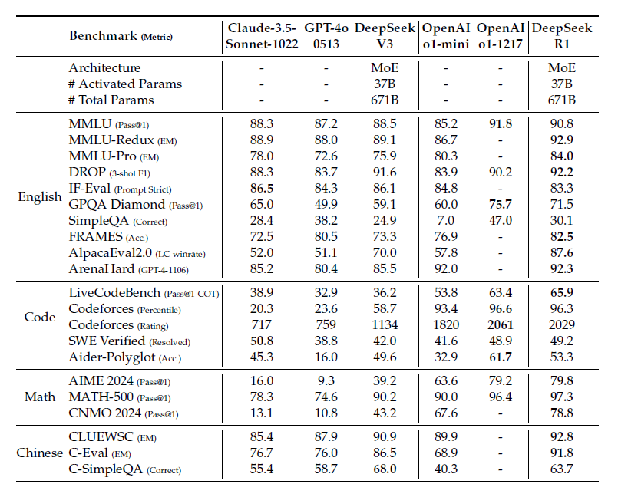
GPT o1 v.s. DeepSeek R1
DeepSeek-R1 as good as o1
In Chinese tasks (C-Eval, CLUEWSC), DeepSeek-R1 surpasses other models
https://arxiv.org/abs/2501.12948

Slide 29
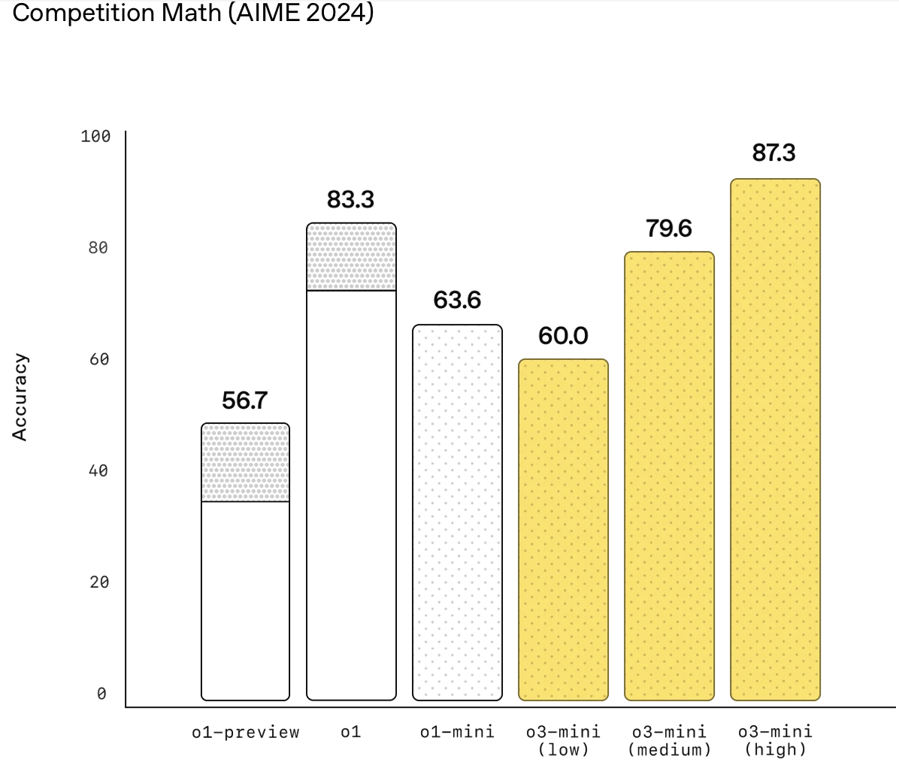
GPT o1 v.s. GPT o3
https://openai.com/index/openai-o3-mini/

Slide 30
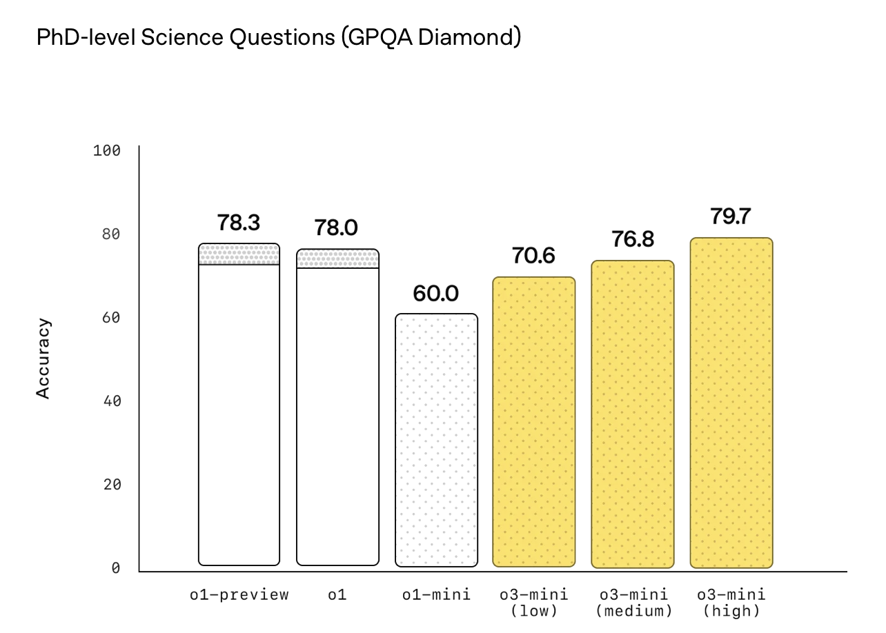
GPT o1 v.s. GPT o3
https://openai.com/index/openai-o3-mini/

Slide 31
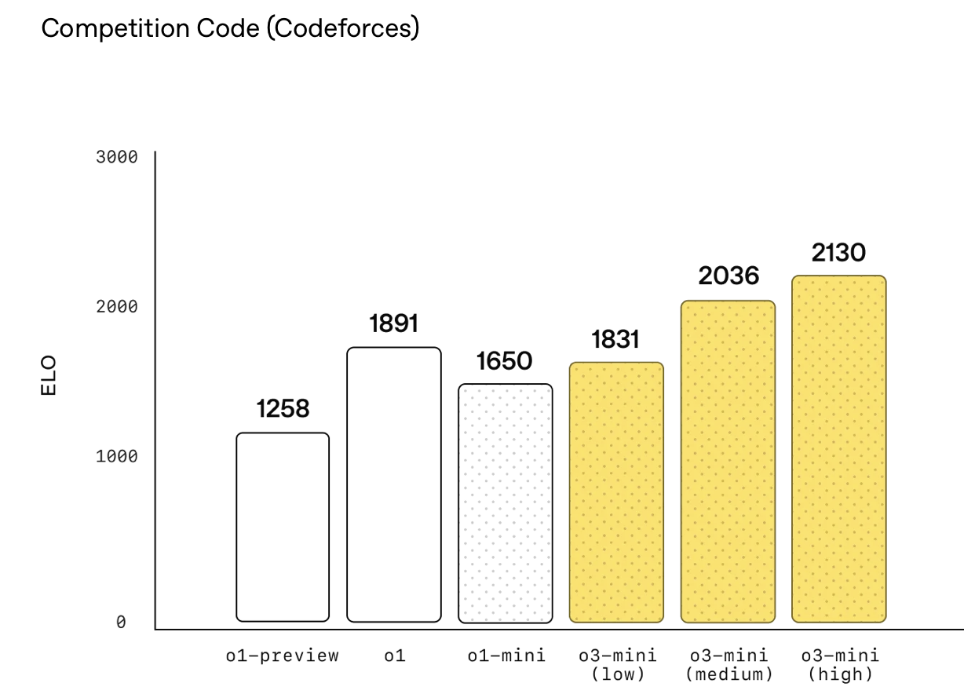
GPT o1 v.s. GPT o3
https://openai.com/index/openai-o3-mini/

Slide 32
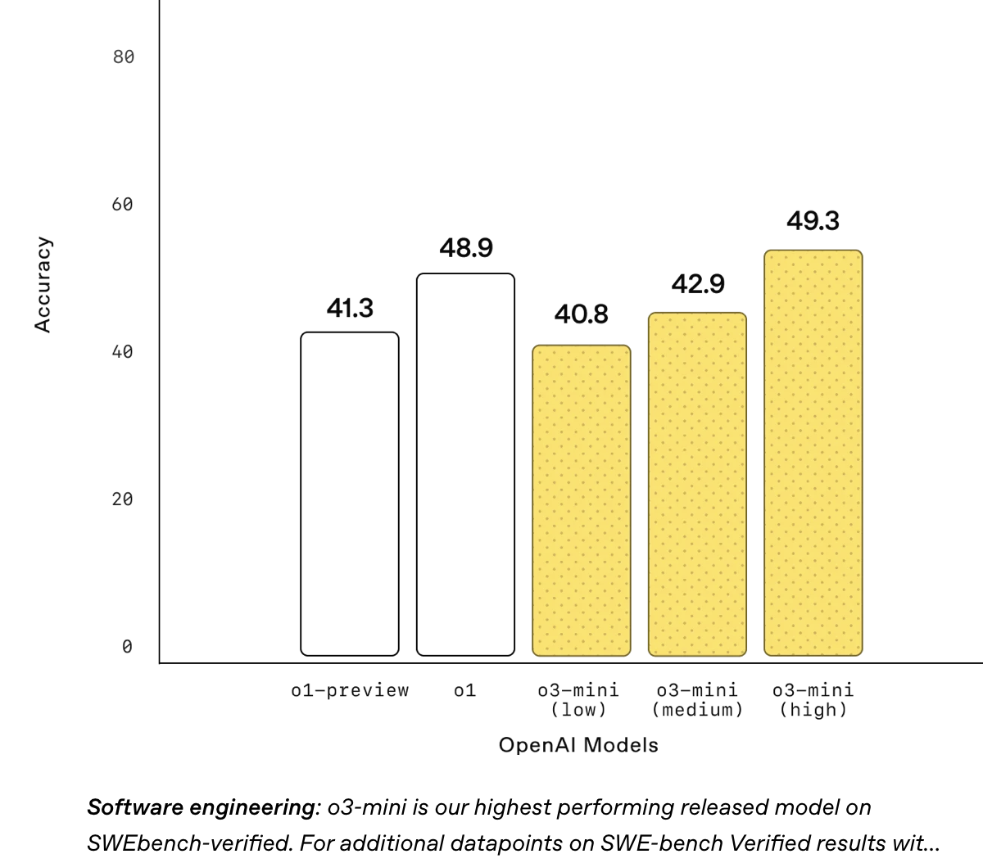
GPT o1 v.s. GPT o3
https://openai.com/index/openai-o3-mini/

Slide 33
Prompt Suggestions for Reasoning Language Models
Keep the prompt simple and direct.
Avoid "think step by step" type prompts.
Use separators for clarity.
In retrieval-augmented generation (RAG), limit the additional context to only the most relevant information to prevent the model's responses from becoming overly complex.
229

Slide 34
Enhancing Reasoning in Language Models with Reinforcement Learning
Challenges in reasoning: Reasoning tasks often involve multiple steps and require understanding context.
Limitations of Supervised Learning: May not effectively handle tasks with delayed rewards or complex decision-making processes.
Reinforcement Learning: Models learn optimal behaviors through interactions and feedback, making it suitable for tasks requiring sequential decision-making.
229

Slide 35
DeepSeek-R1-Zero and Group Relative Policy Optimization (GRPO)
Group Evaluation: For each state, multiple actions are sampled, and their relative advantages are assessed.
Policy Update: The model adjusts its policy to favor actions that perform better relative to others.
229

Slide 36
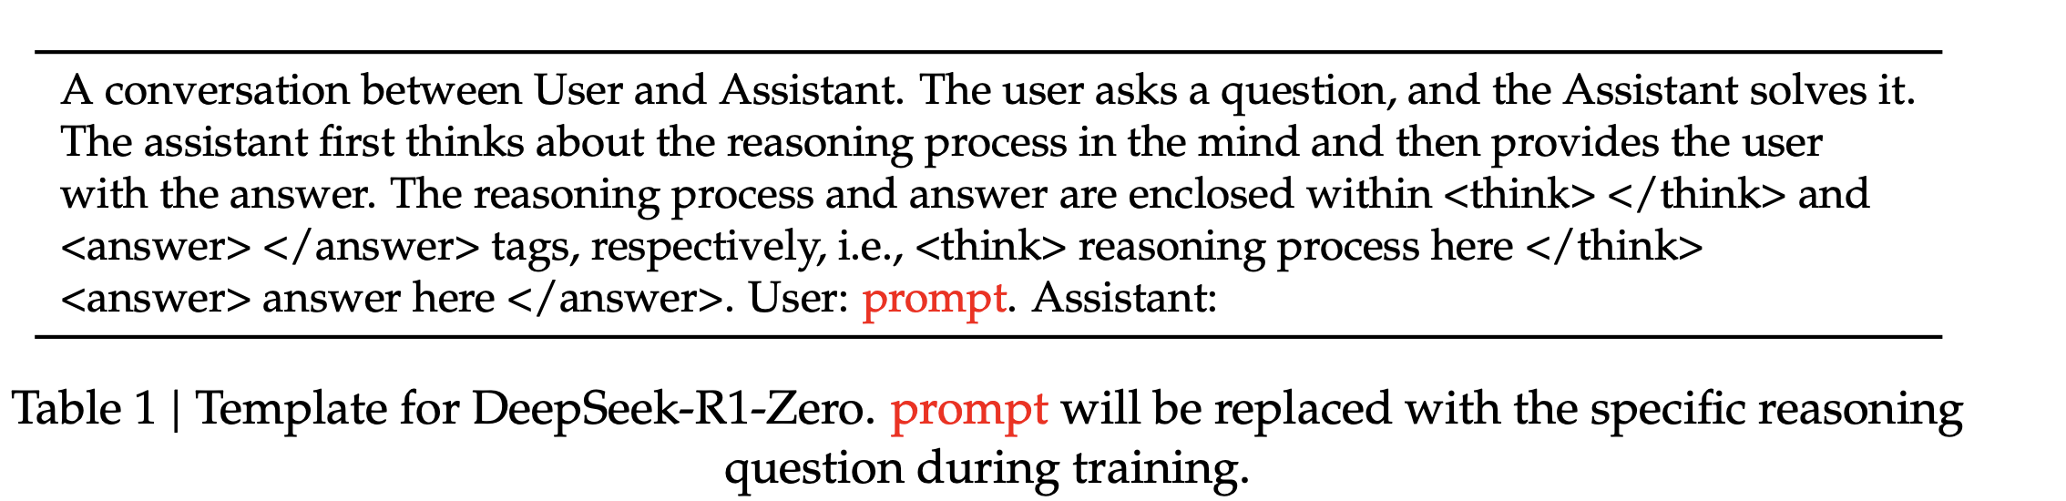
DeepSeek-R1-Zero and Group Relative Policy Optimization (GRPO)
Reward Modeling: Accuracy rewards & Format rewards (enforces the model to put its thinking process )
Training Template: structural format, avoiding any content-specific biases
229

Slide 37
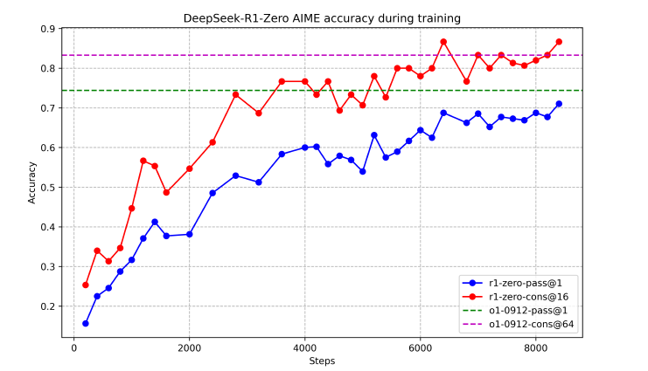
DeepSeek-R1-Zero and Group Relative Policy Optimization (GRPO)
DeepSeek-R1-Zero demonstrates a steady and consistent enhancement in performance as the RL training advances.
Additionally, through the application of majority voting, DeepSeek-R1-Zero’s performance escalates from 71.0% to 86.7% on the AIME benchmark.
229

Slide 38
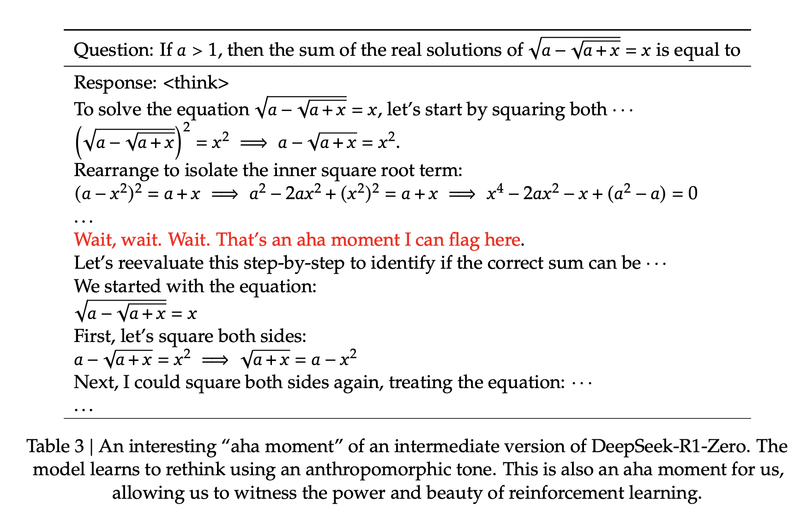
DeepSeek-R1-Zero’s learning to rethink

Slide 39
Paper Sharing -1
Slides from Su Guojun

Slide 40
DeepSeek-R1: Incentivizing Reasoning Capability in LLMs via Reinforcement Learning
Authors: DeepSeek-AI
Course: Computational Linguistics
Date: 2025.2.13
Presenter: SU Guojun

Slide 41
01
Introduction

Slide 42
Introduction
Research Goals:
DeepSeek-R1-Zero
Improve language model reasoning capabilities using pure reinforcement learning (RL)
Address readability and language mixing issues in RL training.
Empower small models via distillation.
DeepSeek-R1
Distillation

Slide 43
02
Approach

Slide 44
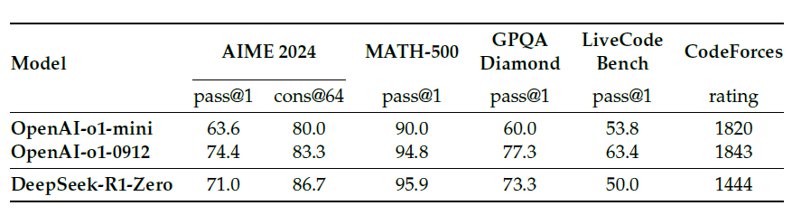
DeepSeek-R1-Zero (pure RL)
Supervised data are time-intensive to gather.
They explore the potential of LLMs to develop reasoning capabilities without any supervised data.
Table1: Comparison of DeepSeek-R1-Zero and OpenAI o1 models on reasoning-related benchmarks:

Slide 45
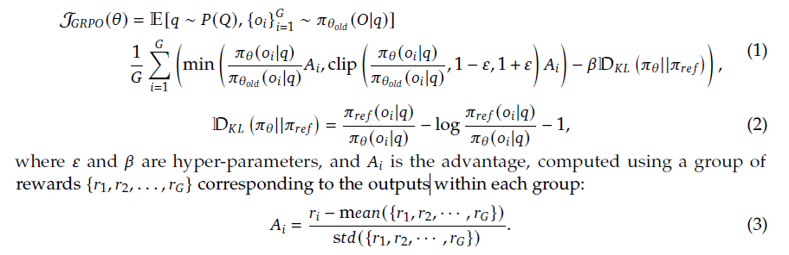
DeepSeek-R1-Zero
Group Relative Policy Optimization, GRPO
GRPO = Just like a student reviewing their homework, identifying correct and incorrect answers, learning from mistakes, and becoming smarter for the next exam! 🎓

Slide 46
DeepSeek-R1-Zero
Reward Modeling
They adopt a rule-based reward system that mainly consists of two types of rewards. (Accuracy rewards & Format rewards)
They do not apply the outcome or process neural reward model.
Training Template
They limit their constraints to structural format, avoiding any content-specific biases to ensure that they can accurately observe the model’s natural progression during the RL process.

Slide 47
DeepSeek-R1-Zero
Exciting Results
DeepSeek-R1-Zero demonstrates a steady and consistent enhancement in performance as the RL training advances.
Additionally, through the application of majority voting, DeepSeek-R1-Zero’s performance escalates from 71.0% to 86.7% on the AIME benchmark.

Slide 48
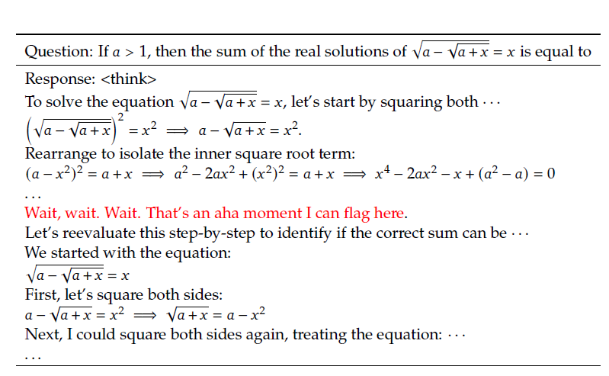
DeepSeek-R1-Zero
An interesting “aha moment”
DeepSeek-R1-Zero learns to rethink using an anthropomorphic tone.
“aha moment” serves as a powerful reminder of the potential of RL to unlock new levels of intelligence in artificial systems

Slide 49
DeepSeek-R1
Drawback of DeepSeek-R1-Zero
DeepSeek-R1-Zero struggles with challenges like poor readability, and language mixing.
They explore DeepSeek-R1, a method that utilizes RL with human-friendly cold-start data.
They construct and collect a small amount of long CoT data to fine-tune DeepSeek-R1 as the initial RL actor.

Slide 50
DeepSeek-R1
Readability(A key limitation of DeepSeek-R1-Zero):
They design a readable pattern:
1.includes a summary at the end of each response
2.filters out responses that are not reader-friendly
3.they define the output format as
|special_token|<reasoning_process>|special_token|<summary>
After that, they apply the same large-scale reinforcement learning training process as employed in DeepSeek-R1-Zero

Slide 51
DeepSeek-R1
Language Mixing
They introduce a language consistency reward.
Although experiments show that such alignment results in a slight degradation in the model’s performance, this reward aligns with human preferences.
Final Reward
Accuracy of reasoning tasks
Reward for language consistency

Slide 52
DeepSeek-R1
Secondary Reinforcement Learning Stage
Aimed at improving the model’s helpfulness and harmlessness
For helpfulness: they focus on the final summary, ensuring that the assessment emphasizes the utility and relevance of the response to the user.
For harmlessness: they evaluate the entire response of the model, to identify and mitigate any potential risks, biases, or harmful content that may arise.

Slide 53
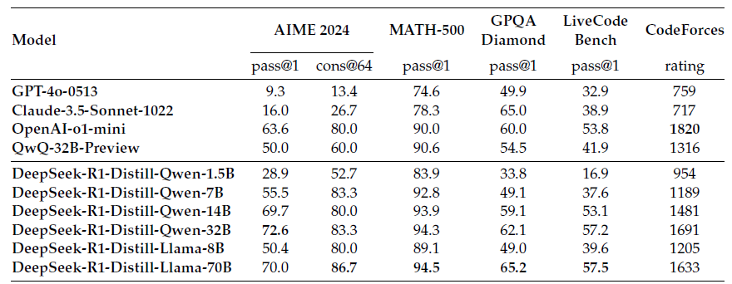
Distillation
Empower Small Models with Reasoning Capability
They directly fine-tuned open-source models like Qwen and Llama.
This straightforward distillation method significantly enhances the reasoning abilities of smaller models.

Slide 54
03
Experiment

Slide 55
DeepSeek-R1 Evaluation
DeepSeek-R1 outperforms GPT-4o and OpenAI-o1-mini in multiple reasoning tasks, even approaching or surpassing OpenAI-o1-1217 in certain benchmarks.
In Chinese tasks (C-Eval, CLUEWSC), DeepSeek-R1 significantly surpasses other models, achieving an impressive accuracy of 91.8% on C-Eval.

Slide 56
04
Future Work

Slide 57
Future Work
General Capability: the capabilities of DeepSeek-R1 fall short of DeepSeek-V3 in tasks such as function calling, multi-turn, complex role-playing, and JSON output.
Language Mixing: DeepSeek-R1 might use English for reasoning and responses, even if the query is in a language other than English or Chinese.
Prompting Engineering: Few-shot prompting consistently degrades its performance. Therefore, they recommend users directly describe the problem and specify the output format.
Software Engineering Tasks: Due to the long evaluation times, which impact the efficiency of the RL process, large-scale RL has not been applied extensively in software engineering tasks.

Slide 58
Paper Sharing -2
Slides from Li Xinqing

Slide 59



OPENCITY: A SCALABLE PLATFORM TO SIMULATE URBAN ACTIVITIES WITH MASSIVE LLM AGENT

Slide 60
OVERVIEW
Background
Case Study
Highlights
Conclusion
Experimrntal Results

Slide 61

BACKGROUND
Urban simulation can simulate the behavior of large-scale crowds, such as traffic congestion, crowd movement, and social segregation.
LLM-based agents are capable of generating more realistic behavior, but are computationally expensive and slow to simulate. Previous studies have only been able to simulate small villages with 15 agents and cannot support large-scale simulations at the city level.
OpenCity aims to solve this problem by making large-scale city simulation efficient and feasible.

Slide 62
HIGHLIGHTS
LLM Request Scheduler
Group-and-Distill Prompt Optimization
User-Friendly Web Portal
These innovations allow OpenCity to run efficiently on common hardware and support large-scale city simulations

Slide 63
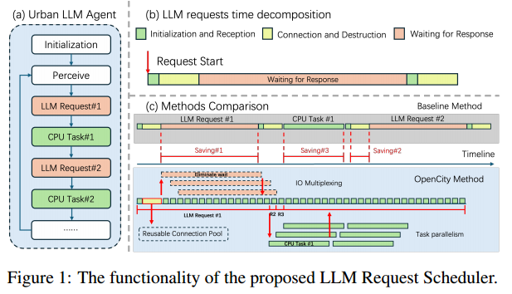

Slide 64
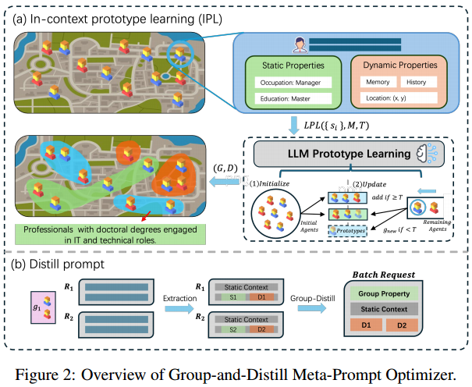

Slide 65
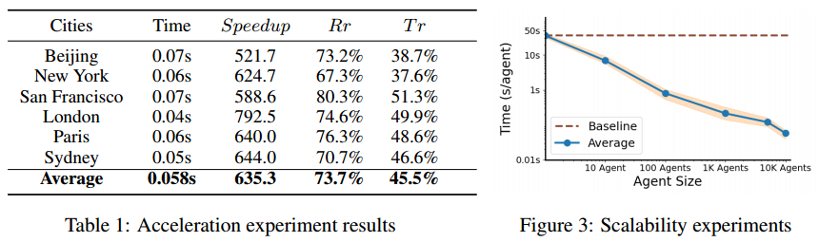
EXPERIMENTAL RESULTS
EFFICIENCY GAINS
OpenCity achieves a 600x speedup, reducing the simulation time per agent from 36.25 seconds to just 0.06 seconds. OpenCity reduces the number of LLM requests by 73.7% and token consumption by 45.5%, significantly lowering computational costs.

Slide 66
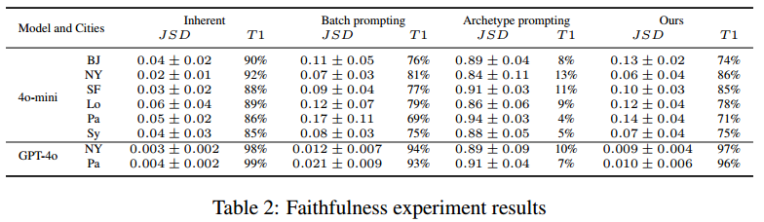
EXPERIMENTAL RESULTS
BEHAVIORAL FIDELITY
With powerful LLMs like GPT-4, OpenCity achieves a Top-1 hit rate of up to 96%, demonstrating its ability to accurately replicate real-world behaviors.

Slide 67
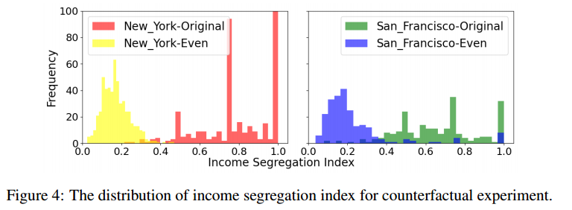
CASE STUDY：COUNTERFACTUAL URBAN SEGREGATION ANALYSIS
This suggests that residential policies play a crucial role in shaping urban segregation. OpenCity allows us to explore such policy impacts and design optimal strategies for the future.

Slide 68
CONCLUSION
Value of OpenCity: efficient, scalable urban simulation tool that supports interdisciplinary research.
Future Directions: Expand to transportation planning, public health, etc., combining multimodal data to enhance realism, etc.
Open source code: Publicly available, more researchers are welcome to participate.
https://github.com/tsinghua-fib-lab/Anonymous-OpenCity

Slide 69
Paper Sharing -3
Slides from Zhang Yepeng

Slide 70
From Local to Global: A Graph RAG Approach to Query-Focused Summarization
Computational Linguistics Presentation
Graph RAG for Large-Scale Summarization
Reporter: ZHANG Yepeng Date: Feb 13th
yepengzhang@link.cuhk.edu.cn

Slide 71
Outline
Computational Linguistics Presentation
A Simple Example: Personal Knowledge Base (KB)
RAG & Its Limitations
Graph RAG: Advantages & Pipeline
Evaluation & Comparison
Additional Applications
Discussion & Conclusion
yepengzhang@link.cuhk.edu.cn

Slide 72
Part 1:A Simple Example Application
Computational Linguistics Presentation
Building a Personal Knowledge Base with Graph RAG
Idea: Use Graph RAG to organize your own notes and documents. Goal: Quickly retrieve and summarize your personal data.
Application: Turn scattered notes into a cohesive, searchable summary.
yepengzhang@link.cuhk.edu.cn

Slide 73
Personal Knowledge Base: Process
Computational Linguistics Presentation
Collect Materials:
Gather your notes, articles, and documents (e.g., .txt, .docx, Markdown).
Extract Information:
Identify key entities (names, topics) and concepts from each file.
Build a Graph:
Nodes: Each note or concept.
Edges: Links based on similar topics or references.
Query & Summarize:
Ask questions like “What are my thoughts on agile development?”
Receive a concise summary in your own style.
yepengzhang@link.cuhk.edu.cn

Slide 74
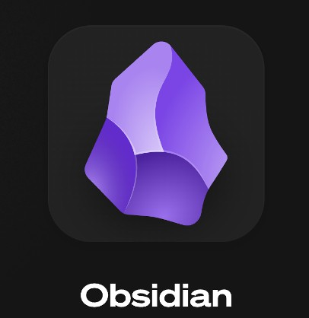
A Powerful Software
Computational Linguistics Presentation
https://obsidian.md/
yepengzhang@link.cuhk.edu.cn

Slide 75
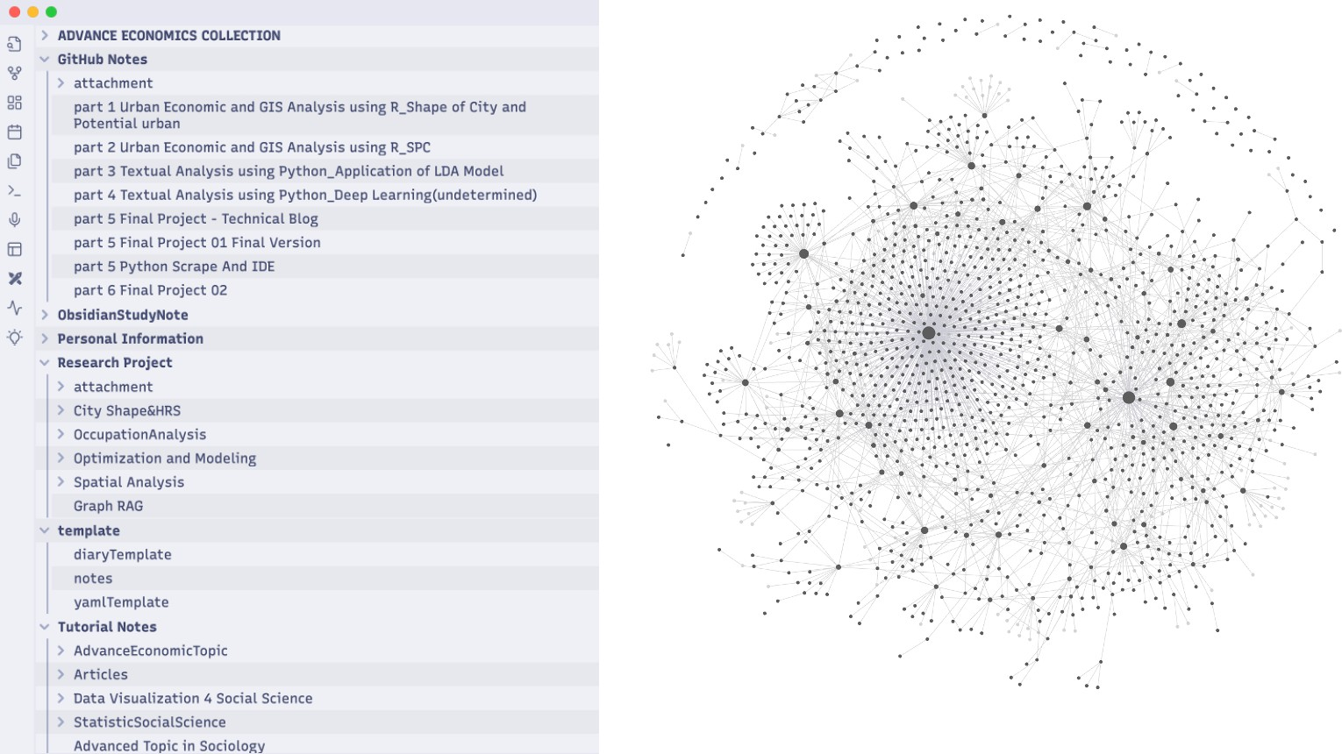
Computational Linguistics Presentation
yepengzhang@link.cuhk.edu.cn

Slide 76
Personal KB: Benefits
Computational Linguistics Presentation
Customized & Private: Your data stays with you. Faster Recall: Quickly find and connect past ideas. Reduced Redundancy: Merges repeated information. Adaptive: Evolves as you add new notes.
yepengzhang@link.cuhk.edu.cn

Slide 77
Part 2: RAG – Definition & Functionality
Computational Linguistics Presentation
What is Retrieval-Augmented Generation (RAG)?
Two-Step Process:
Retrieval: Select relevant text chunks based on a query.
Generation: Use a Large Language Model (LLM) to produce an answer. Function:
Combines external information with LLMʼs internal knowledge.
Works well for fact-based or localized questions.
yepengzhang@link.cuhk.edu.cn

Slide 78
Standard RAG: Limitations
Computational Linguistics Presentation
Local Context Only:
Retrieves nearby text segments, missing the bigger picture.
Limited Token Capacity:
LLMs can process only a fixed number of tokens.
Scaling Issues:
Inefficient when handling millions of tokens.
Fragmented Summaries:
Often produces partial or redundant outputs.
yepengzhang@link.cuhk.edu.cn

Slide 79
Graph RAG: Advantages
Computational Linguistics Presentation
Global Summarization:
Captures cross-document relationships.
Knowledge Graph Construction:
Extracts entities and relationships to build a thematic graph.
Community Detection:
Groups related information into “communities” for focused summaries.
Multi-Stage Query Answering:
Combines partial summaries into one comprehensive answer.
yepengzhang@link.cuhk.edu.cn

Slide 80
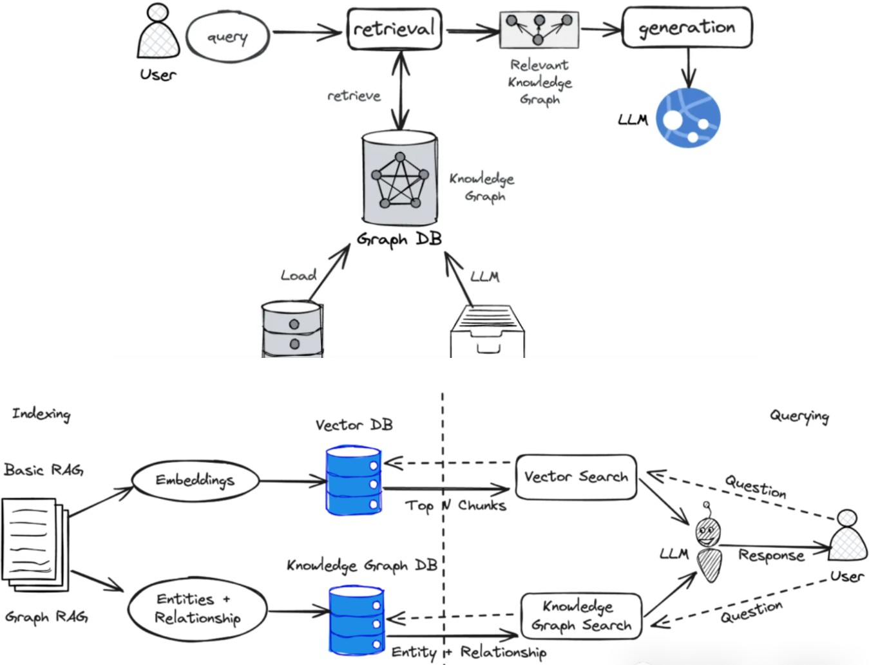
Computational Linguistics Presentation
yepengzhang@link.cuhk.edu.cn

Slide 81
Graph RAG Pipeline Overview
Computational Linguistics Presentation
Two Main Stages:
Indexing (Offline):
Document Splitting → Entity & Relation Extraction → Knowledge Graph Construction → Community Detection → Community Summarization.
Query (Online):
Relevant Community Identification → Partial Answers Generation → Final Answer Aggregation.
yepengzhang@link.cuhk.edu.cn

Slide 82
Part 3: Evaluation & Results
Computational Linguistics Presentation
Datasets & Experimental Setup
Podcast Transcripts: ~1 million tokens. News Articles: ~1.7 million tokens.
Queries:
Designed for global understanding (e.g., “What themes emerge across all episodes?”).
~125 test questions per dataset.
yepengzhang@link.cuhk.edu.cn

Slide 83
Evaluation Metrics
Computational Linguistics Presentation
Metric | Definition
Comprehensiveness | Coverage of all relevant aspects in the query
Diversity | Inclusion of varied perspectives or subtopics
Empowerment | Helps users make well-informed decisions
Directness | Clearly and accurately addresses the userʼs question
yepengzhang@link.cuhk.edu.cn

Slide 84
Results Overview
Computational Linguistics Presentation
Graph RAG vs. Naïve RAG (Simple Chunk Retrieval): Comprehensiveness: +72–83%
Diversity: +75–82%
Better cross-document insight.
Graph RAG vs. Text Summarization (Map-Reduce): More targeted summaries.
Comparable or lower token usage.
Often better structured for global queries.
yepengzhang@link.cuhk.edu.cn

Slide 85
Part 4: Additional Application Scenarios (working on)
Computational Linguistics Presentation
Scenario 1: Simulation Study
Example: Bilibili Representative Users
Collect Data:
Crawl all videos, images, and comments from a specific Bilibili topic.
Store them in a text format (like .txt or .json).
Use APIs (DeepSeek V3, KIMI mooncake):
Split comments and descriptions into chunks.
Build logical links among chunks (e.g., shared keywords, user sentiments). Create a Knowledge Graph of comments and their relationships.
yepengzhang@link.cuhk.edu.cn

Slide 86
Example: Bilibili Representative Users
Computational Linguistics Presentation
Ask Questions:
For instance, “What is the community's general opinion on Topic X?”
The AI uses the knowledge graph to see how comments connect, find relevant text chains, and refer to your “system prompts.”
It then summarizes the most common attitude among the Bilibili community about Topic X.
Migration to Other Communities:
The same approach can work on other platforms or forums.
Build a knowledge graph of comments, then ask questions to see the collective views of that group.
yepengzhang@link.cuhk.edu.cn

Slide 87
Scenario 2: Economics Literature Review
Computational Linguistics Presentation
Problem: Reviewing and synthesizing many economics papers. Approach:
Collect Texts: Download economics articles and papers.
Extract Relationships: Identify references, theories, and data trends.
Build Graph: Link papers based on common topics (e.g., inflation, market models).
Query: “How do these theories connect to shape new economic arguments?” Outcome: A comprehensive summary that shows how literature fits together.
yepengzhang@link.cuhk.edu.cn

Slide 88
Discussion & Conclusion
Computational Linguistics Presentation
Key Observations
Graph RAG bridges the gap between local retrieval and global understanding. Combines knowledge graphs with community summaries to offer comprehensive answers.
Demonstrated effectiveness across diverse datasets and applications.
Conclusion:
Graph RAG provides scalable, holistic summarization for large text corpora. It is useful in personal applications, simulation studies, and literature reviews.
yepengzhang@link.cuhk.edu.cn

